Slide 1
Causal inference for object-tracking during self-motion
Inferring joint posterior beliefs that respect the geometric relationships between motion and depth
(how should belief about object motion evolve over time?)
Jeff Rhoades
Drugowitsch Rotation, Harvard Medical School
February 26, 2020

Slide 2
Lunch time!

Slide 3
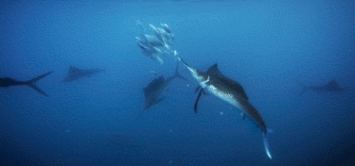
Notes:
What do I need to know, deduce, or infer about the world to get lunch?

Slide 4
Ingredient 1: Model of the world’s state
#gnothi seauton
Notes:
What do I need to know, deduce, or infer about the world to get lunch?

Slide 6
Ingredient 2: Model of world’s evolution given current state estimates
1) what is
(what will* be)
Notes:
GO TO BOARD FOR KALMAN FILTER:
Z = latent state
C = emission matrix
A = transmission matrix
μn = Aμn−1 +Kn(xn − CAμn−1)
Vn = (I −KnC)Pn−1
Pn−1 = AVn−1A’ + Γ
(Γ is transition noise)
Kn = Pn−1C’ *(CPn−1C’ + Σ)^−1

Slide 9
Ingredient 2: Model of world’s evolution given current state estimates
1) what is
(what could* happen)
Notes:
Go to board for inference:
Given MSE as cost function → results in weighted mean of Model estimates

Slide 10
1) what could happen
1) what is
(what will* be)
Ingredient 3: Control Scheme
Notes:
Go to board for decision cost function

Slide 11
Ingredient 4: Experiment
Does the brain encode only the expected point object interception, or dynamically update the object’s predicted location in real time?

